Slide 1
HOSPITAL DATABASE MANAGEMENT SYSTEM
Beyza YILDIRIM

Slide 2
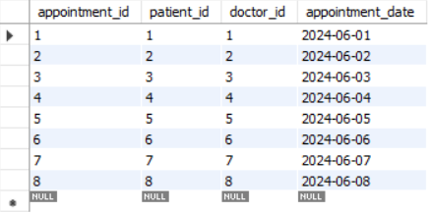
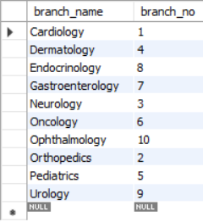
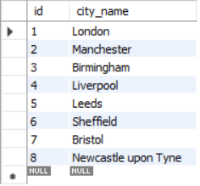
Hospital Database
For this Project, hospitalDB database was created.
Using this database, appointment, branch, city, district, doctor, drug, examination, hospitalization, nurse, patient, prescription, prescription_medicine, room, room_movements tables were created.
appointment table
branch table
city table

Slide 3
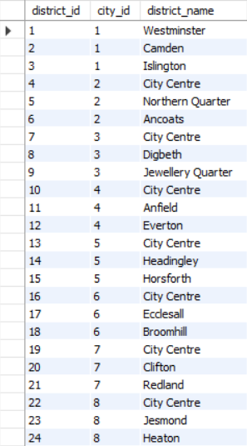
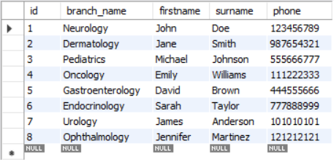
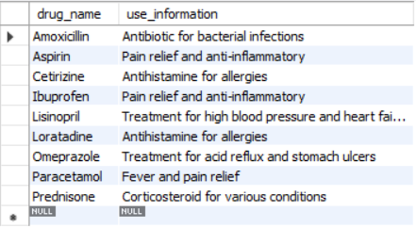
district table
doctor table
drug table

Slide 4
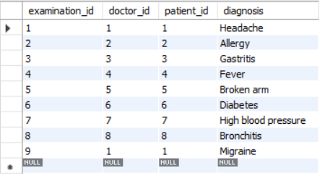
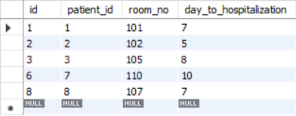
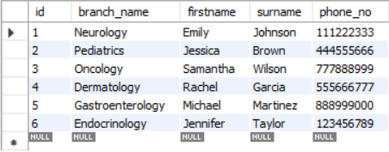
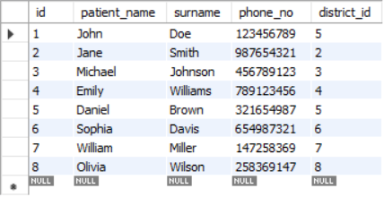
examination table
hospitalization table
nurse table
patient table

Slide 5
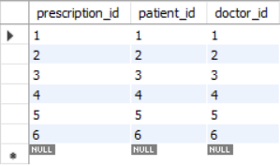
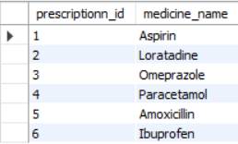
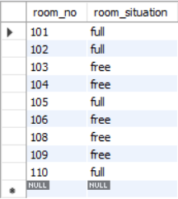
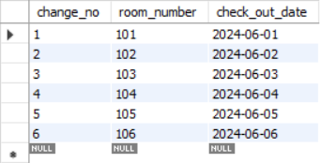
prescription table
prescription_medicine table
room table
room_movements table

Slide 6
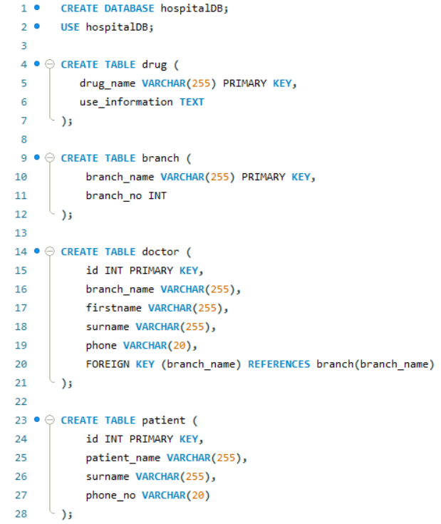
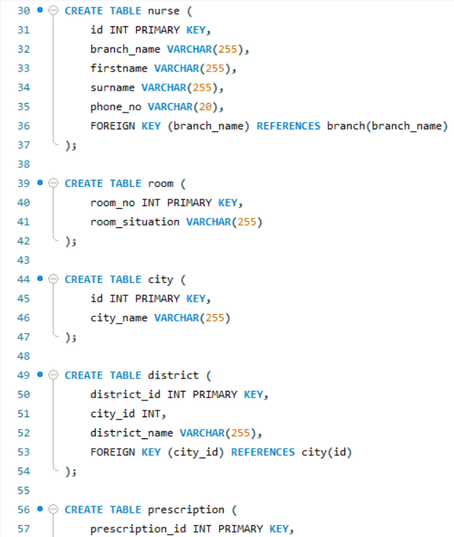
Create Table Codes

Slide 7
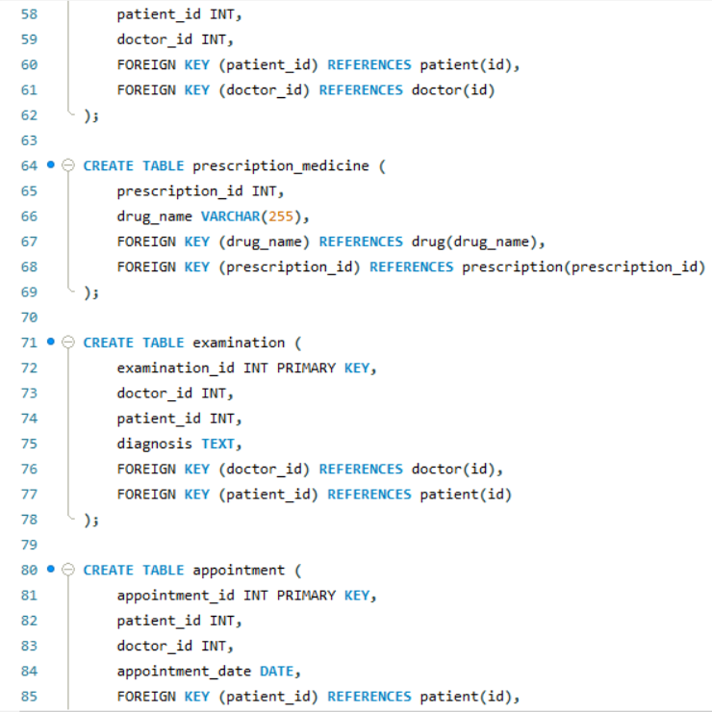
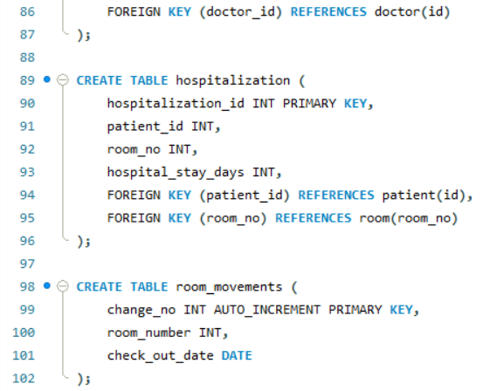

Slide 8
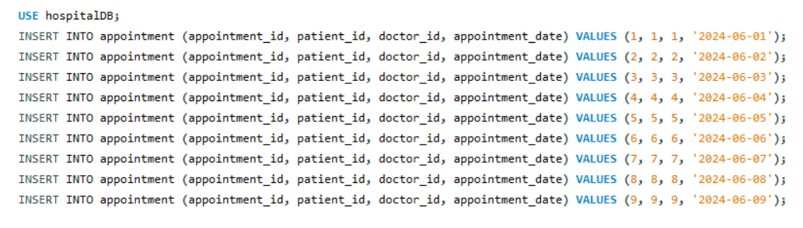
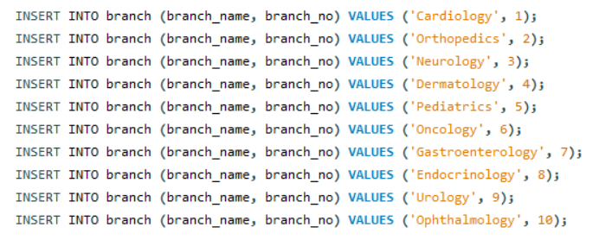
Insert Into Codes

Slide 9
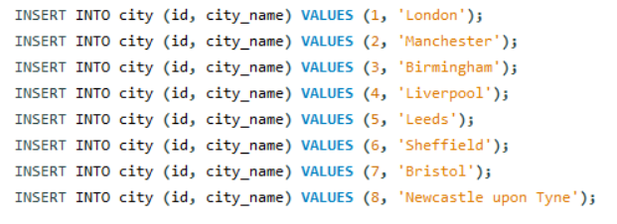
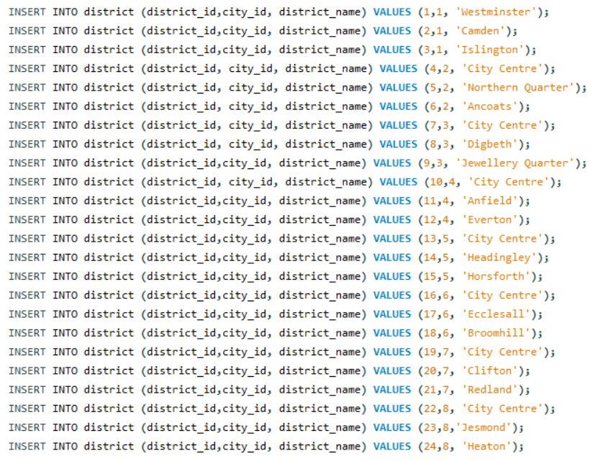

Slide 10
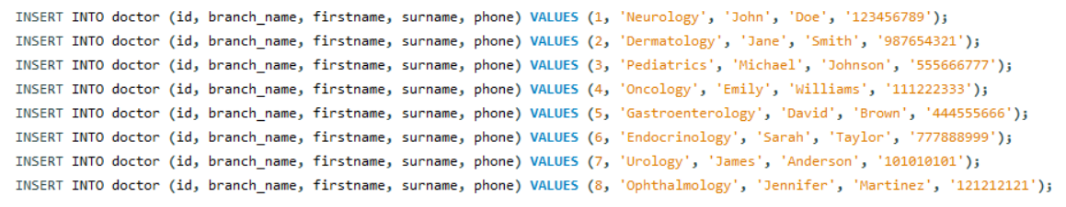
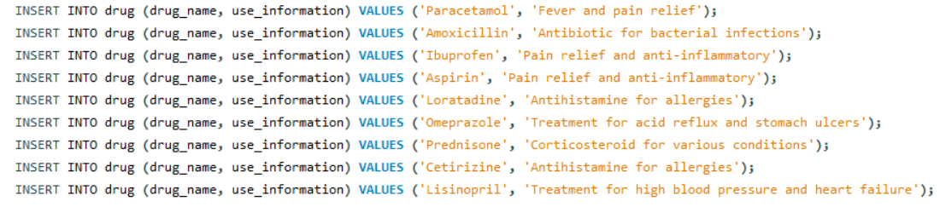

Slide 11
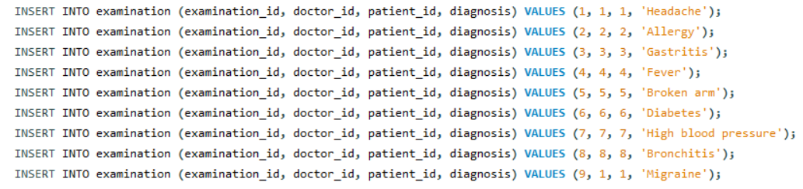
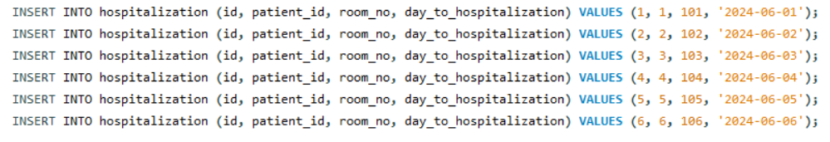

Slide 12
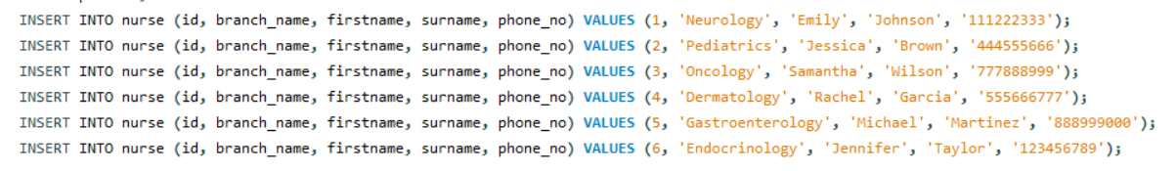
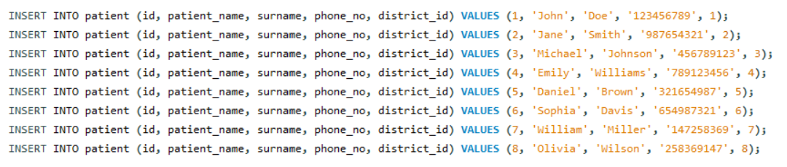

Slide 13
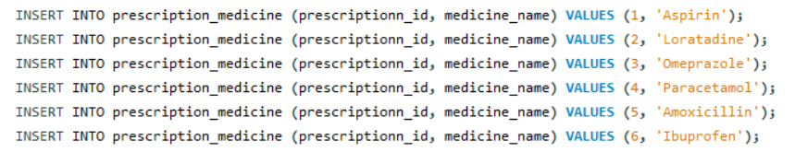
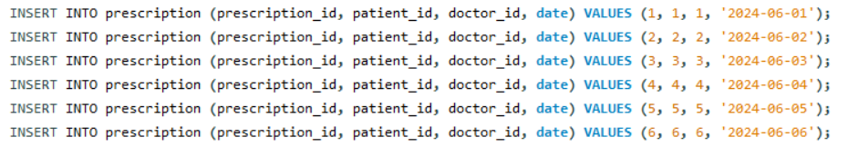

Slide 14
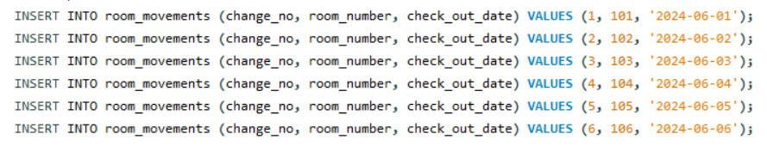
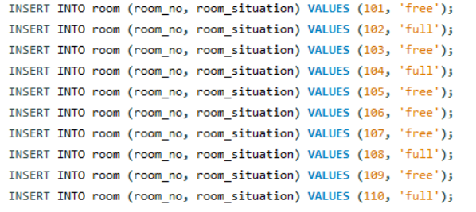

Slide 15
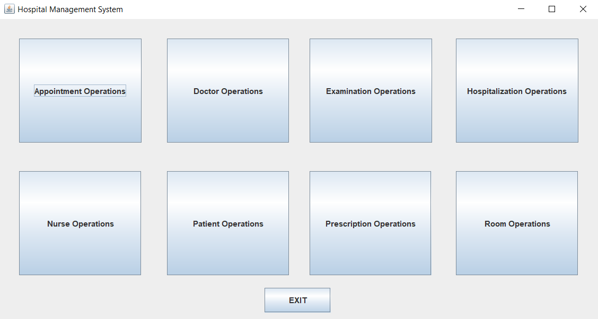
HOSPITAL DATABASE APPLICATION

Slide 16
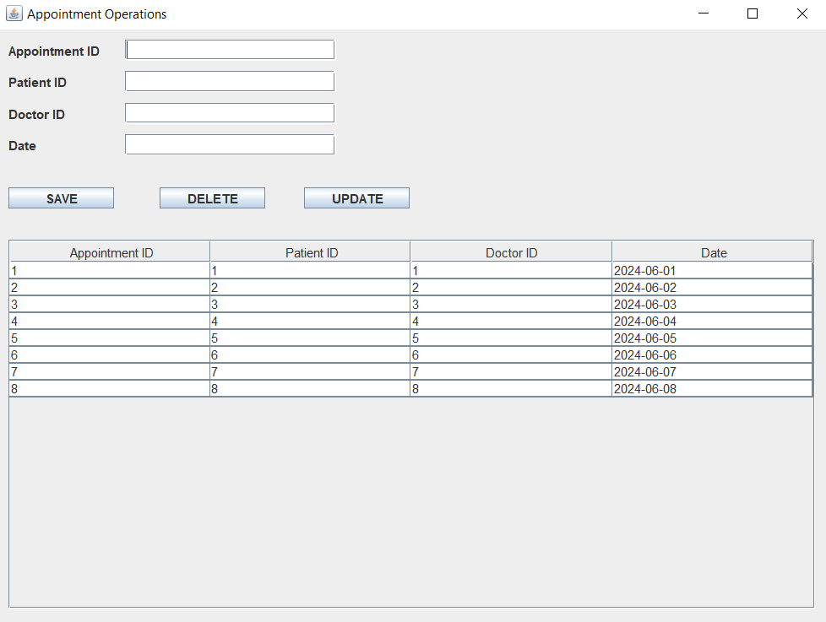
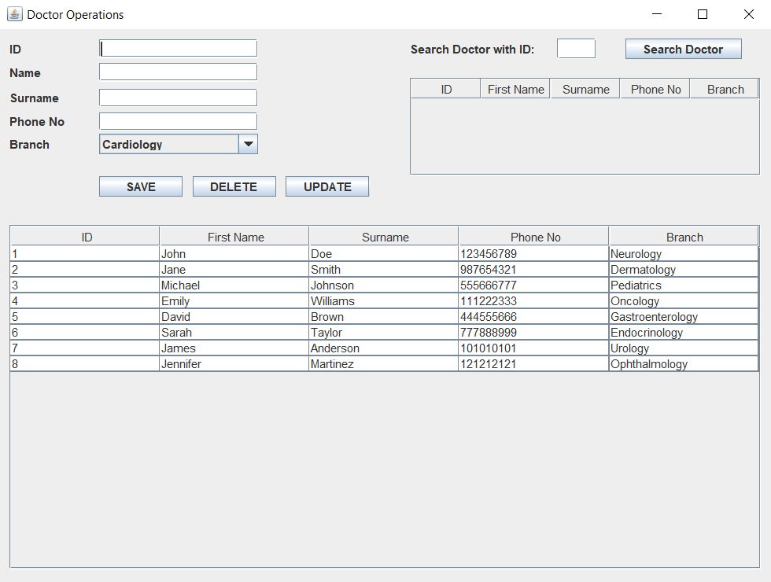
Appointment Operations
Doctor Operations

Slide 17
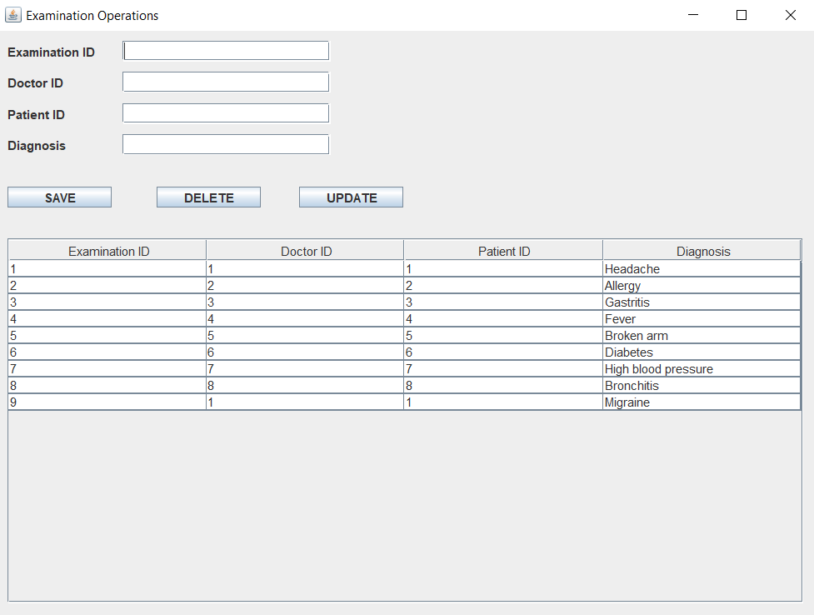
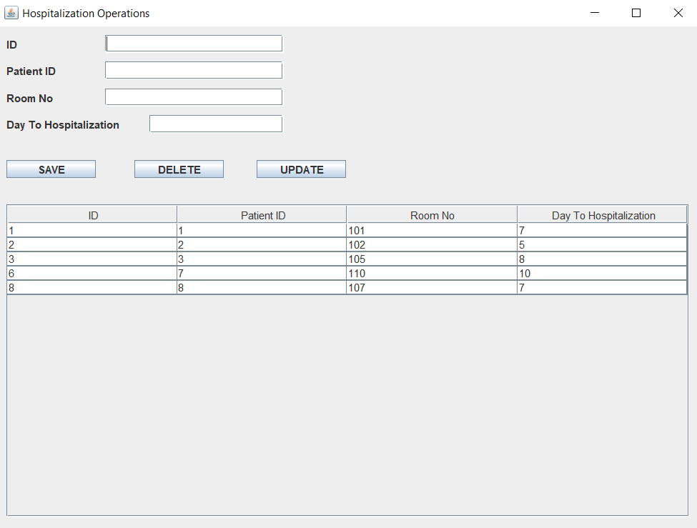
Examination Operations
Hospitalization Operations

Slide 18
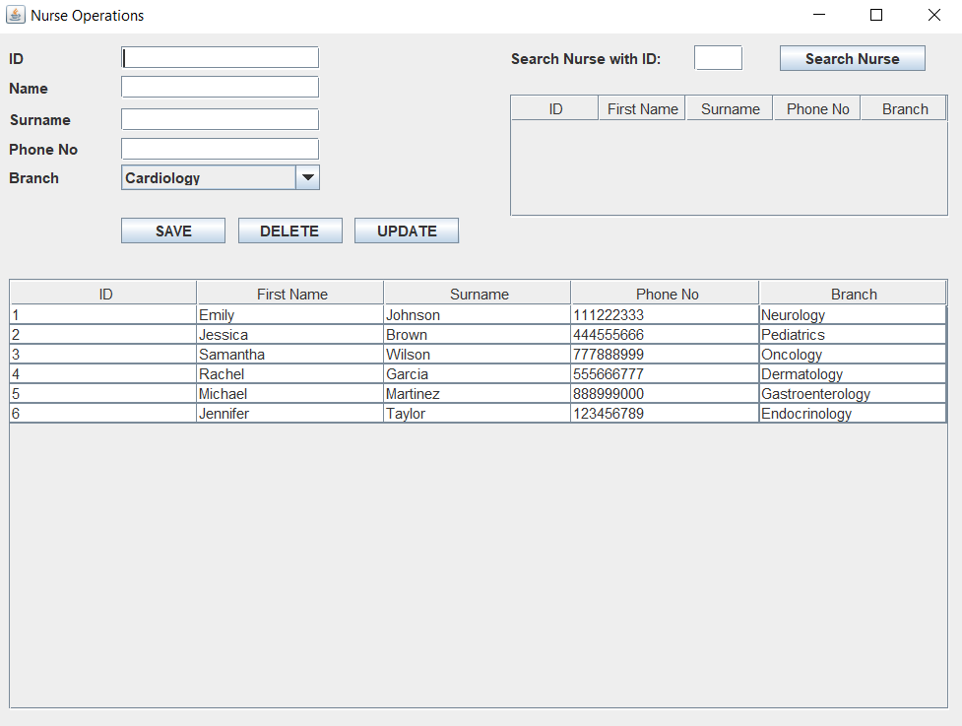
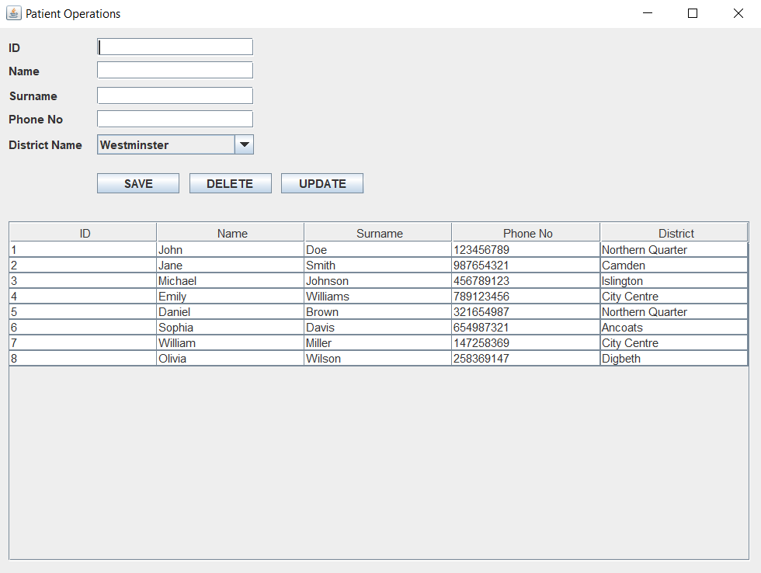
Nurse Operations
Patient Operations

Slide 19
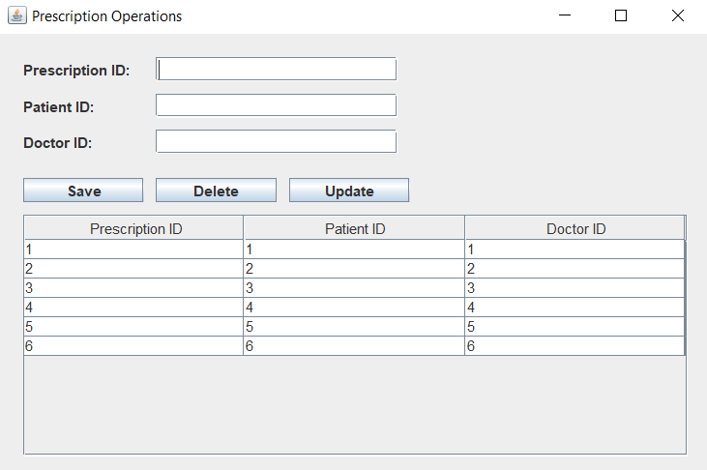
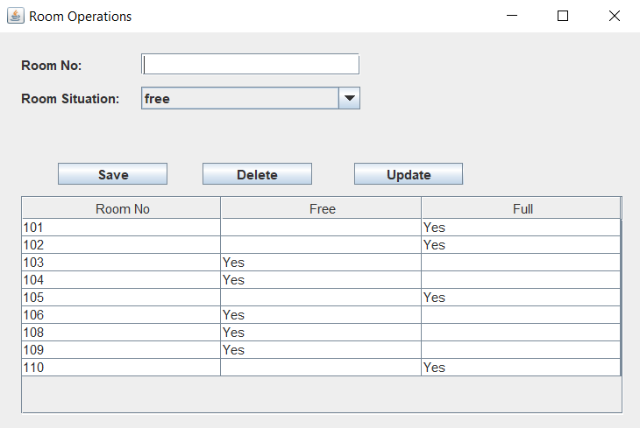
Prescription Operations
Room Operations

Slide 20
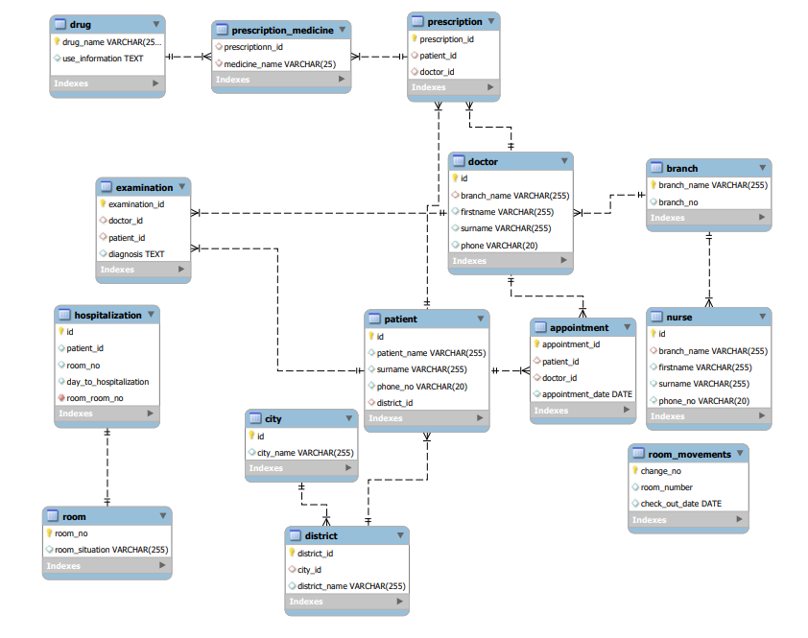
ER Diagram

Slide 21
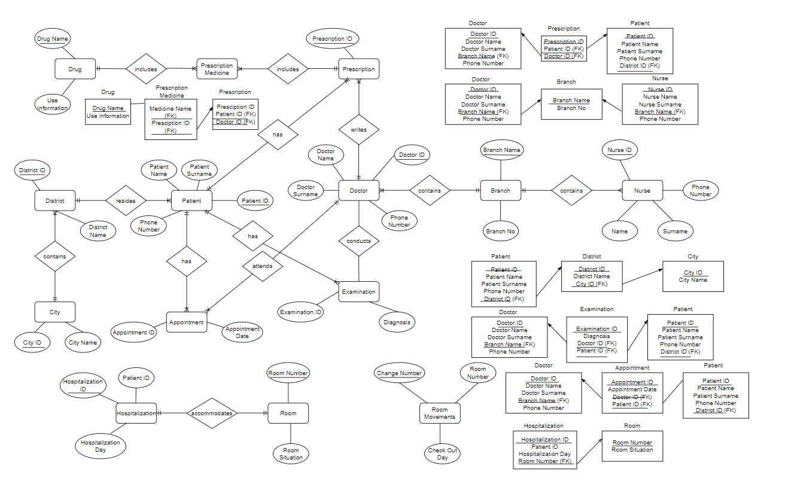
Reliational Schema

Slide 22
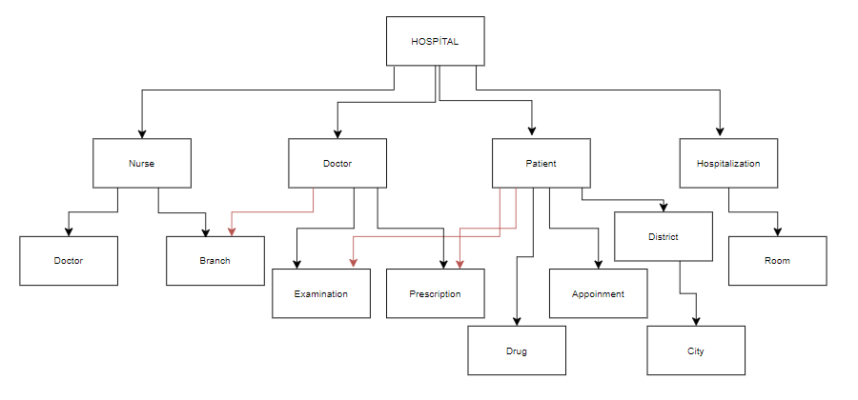
Organizational Chart

Slide 23
Data Dictionary
Tables
drug
Columns:
drug_name (VARCHAR): Primary key, the name of the drug
use_information (TEXT): Information about the use of the drug
branch
Columns:
branch_name (VARCHAR): Primary key, name of the branch
branch_no (INT): Branch number
doctor
Columns:
id (INT): Primary key, unique identifier for the doctor
branch_name (VARCHAR): Name of the branch the doctor belongs to
firstname (VARCHAR): First name of the doctor
surname (VARCHAR): Last name of the doctor
phone (VARCHAR): Phone number of the doctor
Foreign Key:
branch_name references branch(branch_name)

Slide 24
patient
Columns:
id (INT): Primary key, unique identifier for the patient
patient_name (VARCHAR): Name of the patient
surname (VARCHAR): Last name of the patient
phone_no (VARCHAR): Phone number of the patient
nurse
Columns:
id (INT): Primary key, unique identifier for the nurse
branch_name (VARCHAR): Name of the branch the nurse belongs to
firstname (VARCHAR): First name of the nurse
surname (VARCHAR): Last name of the nurse
phone_no (VARCHAR): Phone number of the nurse
Foreign Key:
branch_name references branch(branch_name)
room
Columns:
room_no (INT): Primary key, room number
room_situation (VARCHAR): Situation/status of the room.

Slide 25
city
Columns:
id (INT): Primary key, unique identifier for the city
city_name (VARCHAR): Name of the city
district
Columns:
district_id (INT): Primary key, unique identifier for the district
city_id (INT): Foreign key, references the city table
district_name (VARCHAR): Name of the district
Foreign Key:
city_id references city(id)
prescription
Columns:
prescription_id (INT): Primary key, unique identifier for the prescription
patient_id (INT): Foreign key, references the patient table
doctor_id (INT): Foreign key, references the doctor table
Foreign Key:
patient_id references patient(id)
doctor_id references doctor(id).

Slide 26
prescription_medicine
Columns:
prescription_id (INT): Foreign key, references the prescription table
drug_name (VARCHAR): Foreign key, references the drug table
Foreign Keys:
prescription_id references prescription(prescription_id)
drug_name references drug(drug_name)
examination
Columns:
examination_id (INT): Primary key, unique identifier for the examination
doctor_id (INT): Foreign key, references the doctor table
patient_id (INT): Foreign key, references the patient table
diagnosis (TEXT): Diagnosis given during the examination
Foreign Keys:
doctor_id references doctor(id)
patient_id references patient(id)

Slide 27
appointment
Columns:
appointment_id (INT): Primary key, unique identifier for the appointment
patient_id (INT): Foreign key, references the patient table
doctor_id (INT): Foreign key, references the doctor table
appointment_date (DATE): Date of the appointment
Foreign Keys:
patient_id references patient(id)
doctor_id references doctor(id)
hospitalization
Columns:
hospitalization_id (INT): Primary key, unique identifier for the hospitalization
patient_id (INT): Foreign key, references the patient table
room_no (INT): Foreign key, references the room table
hospital_stay_days (INT): Number of days the patient stayed in the hospital
Foreign Keys:
patient_id references patient(id)
room_no references room(room_no)
room_movements
Columns:
change_no (INT): Primary key, auto-incremented, unique identifier for room movements
room_number (INT): Room number associated with the movement
check_out_date (DATE): Date of room check-out.

Slide 28
Relationships
Branch:
Contains many doctors
Contains many nurses
City:
Contains many districts
Patient:
Has many prescriptions
Has many examinations
Has many appointments
Has many hospitalizations
Doctor:
Writes many prescriptions
Conducts many examinations
Attends many appointments.

Slide 29
Prescription:
Includes many prescription medicines
Drug:
Is part of many prescription medicines
Room:
Accommodates many hospitalizations.
Nurse:
Belongs to a branch
Provides care to multiple patients
District:
Belongs to a city
Examination: Conducted by a doctor
Associated with a patient

Slide 30
Appointment:
Scheduled for a patient
Conducted by a doctor
Hospitalization:
Involves a patient being assigned to a room
Prescription Medicine:
Belongs to a prescription
Refers to a drug
Room Hospitalization:
Tracks movements of patients in and out of rooms.

